Slide 1
Healthy Habits for Student Athletes
Stephanie Sass, MS RD
Stephanie.sass@wakefern.com
201-819-9619

Slide 2
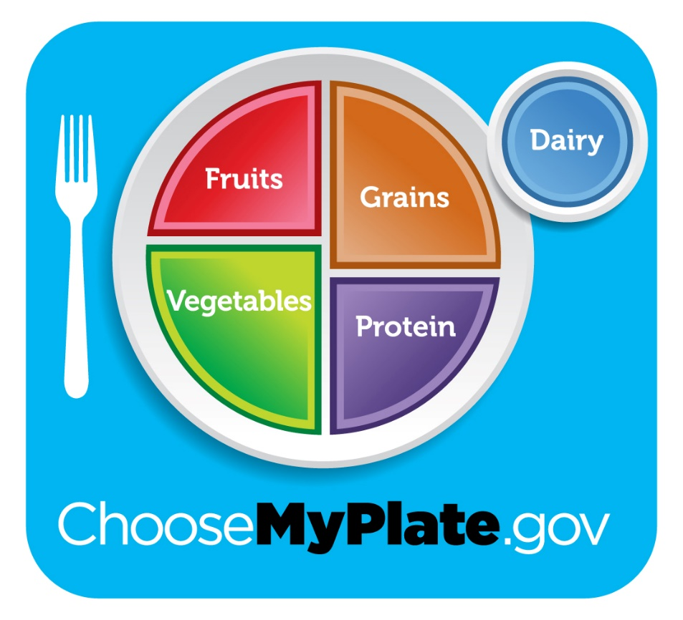
MY Plate
Notes:
I’m sure a lot of you are familiar with MyPlate. This plate tells you how your plate should look. It shows you have half of your plate should be fruits and vegetables while the other half should be grains and protein. A balanced meal also includes a side of dairy. Can anyone tell me a meal they would have for dinner that would include all of these food groups. How about some brown rice for my grain, a piece of grilled chicken for my protein, some steamed broccoli for my vegetables, some mango salsa for my fruit, and a glass of milk for my dairy. If that was my meal, I would have a My Plate dinner. Now it’s not always necessary to include all 5 groups are every meal. We aim to include at least three. Now here is where we get into the real nutrition talk. If I asked most of you could probably name your favorite fruit or vegetables but what if I asked what macronutrient apples are and what do they turn into when they are digested by our stomachs?

Slide 3
All foods breakdown into three macronutrients
Carbohydrates
  Main source of energy
Protein
  Builds your muscles
Fat
  Provides essential fats for protection
Notes:
All food for all of the food groups break down into one of these three categories – This can get confusing. Some foods like dairy can break down into all three macronutrients.

Slide 4
The Basics – Carbohydrates
Carbohydrates are the most important nutrient for athletes
  Glucose is the sugar that comes from carbs
  Glucose is what provides the body and brain with energy
  Carbohydrates also give you B vitamins
    B vitamins also give you an energy boost
Notes:
Now I know a lot of people have their own person beliefs about carbs, but I’m here to tell you that carbs couldn’t be more important for you student athlete. Carbohydrates are our main energy source. Our bodies breakdown carbs into glucose which is the sugar that your body prefers to use as fuel. Glucose fuels our brains and our bodies. If a person is not consuming enough carbs they may feel sluggish, tired, groggy, or irritable. I’m not sure if we have any marathon runners or weight lifters in the building but if you’ve even felt that ‘hit the wall’ feeling when your muscles just can’t take any more – that is glucose depletion. You body has officially used all of the glucose it was storing in it’s muscles to give you energy. Another situation you all might be familiar with – raise your hand if you ever skipped breakfast, okay now keep your hand raised if on those days you’ve skipped breakfast you felt like you couldn’t concentrate or get any work done. Again – this is your body asking for carbohydrates. Carbs fuel everything we do. Imagine how difficult it would be for you to focus on your homework, if you just came from a 3 hour long soccer practice and didn’t eat any carbs. We need to replenish what we use!

Slide 5
The Basics – Carbohydrates
  Provides you with fiber to help you stay full
  When glucose levels are low, a child may become sluggish, tired, groggy, or irritable
  Lack of glucose or carbs can negatively impact athleticism and academics
Notes:
Without carbs you wouldn’t get very far on a soccer field or very far on your homework. You need the glucose from carbs to fuel your body and brain.

Slide 6
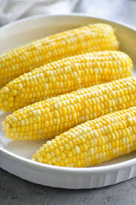


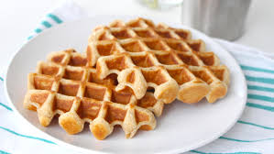

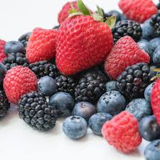
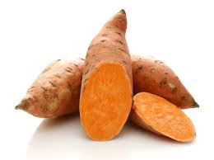
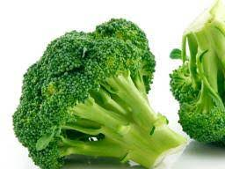
What Counts as a Carbohydrate?
Notes:
So you’ll see that these foods are in different food groups. All of the 5 food groups are important. Fruits, vegetables, and grains give you different vitamins and minerals but once in your body they all breakdown into carbohydrates.

Slide 7
What counts as a carbohydrate choice?
Other choices
Whole wheat/grain choices
Fruits
  Bananas provide the most CHO
Vegetables (starchy)
  Sweet potatoes, white potatoes, butternut squash, radishes, beets, corn
Dairy
  Yogurt, milk, cheese
Sugar, candy, and honey
Bread
Wraps
Oats
Pasta
Rice
Quinoa

Slide 8
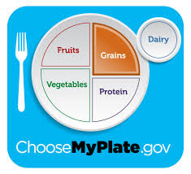
¼ of the plate should be grains, beans, or starchy vegetables

Slide 9
Carbohydrates and Sports
Carbohydrates give you energy
  Without them you wouldn’t be able to run / be active for very long
When to eat carbs
  Meal size – 4 to 6 hours before
    Ex. Pasta with a salad, rice with broccoli and chicken, a peanut butter and jelly sandwich on
  Snack size – 1 – 2 hours before
    Ex. Banana with 1 tbsp. peanut butter, 4-6 peanut butter crackers, 6-8 oz. smoothie, a small yogurt with fruit or granola
  Snack size – 30 to 60 minutes before
    Any small fruit

Slide 10
The basics – Protein
Protein is necessary for building muscle
Dietary protein helps muscles recover from exercise
Inadequate protein intake can cause
  Slower recovery times
  Muscle wasting
  Decrease in athletic performance
  Decreased immune system
Notes:
Muscles build in your body similarly to how legos stack. When you eat protein your body breaks it down into smaller nutrients called amino acids. Amino acids easily attach to pre-existing muscle and thus we see muscle growth with appropriate exercise and eating habits.

Slide 11
Can We name some protein sources
Plant Based and Meat???

Slide 12
What counts as a protein choice?
Animal Proteins
Plant Proteins
Chicken
Fish
Lean cuts of pork (pork loin)
Lean cuts of beef (sirloin, strip, tenderloin)
90-99% lean ground beef
Lean ground turkey
Dairy
Eggs
Nuts and seeds
Nut and seed butters
Tofu and soy beans
Beans and lentils

Slide 13
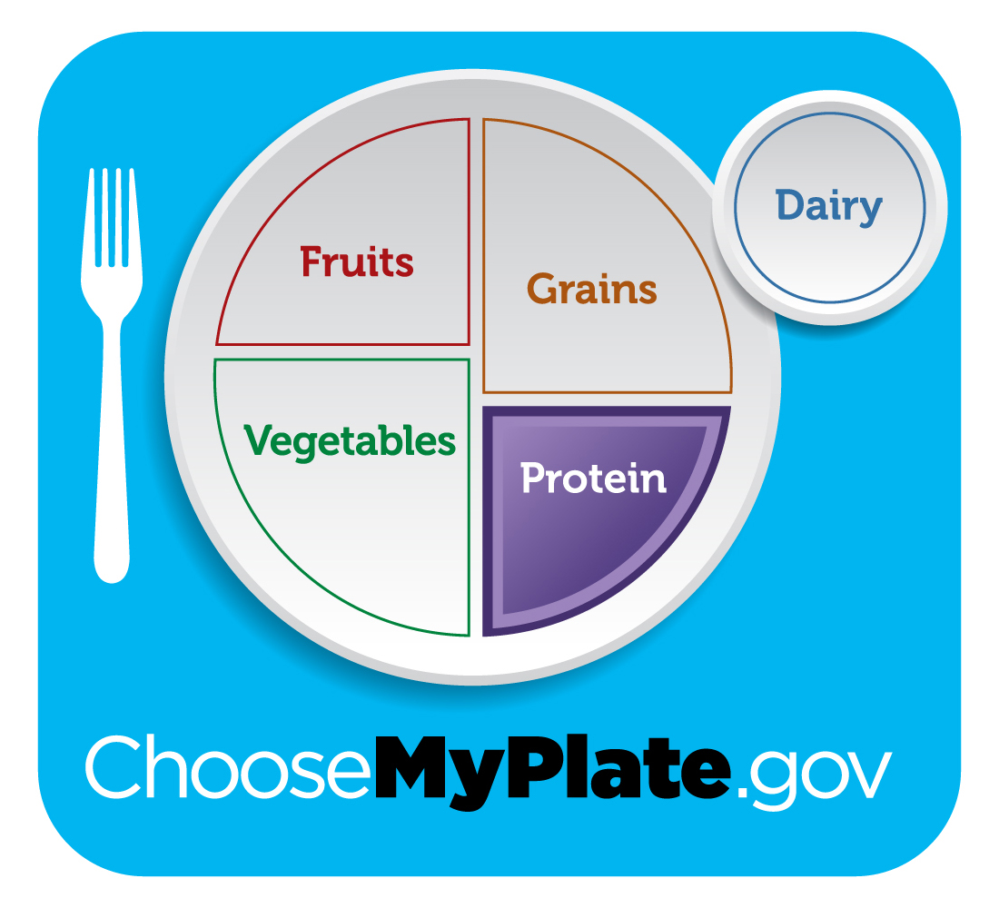
¼ of your plate should be lean protein

Slide 14
Protein Supplements
Most dietary supplements are NOT REGULATED BY THE FDA
Dietary supplements are NOT required to list all of their ingredients
Most American children are consuming 2-3 times their protein needs
Excess proteins can increase risk of dehydration
Excess proteins over a long period of time can cause kidney damage
Notes:
Additionally, most supplement companies do NOT have to list all of their ingredients
Some companies undergo voluntary inspections by the FDA, which the company pays for but it is not required at this time

Slide 15
Recommendations from the American academy of pediatrics
Although athletes might need extra protein if they participate in strenuous physical exercise, the American Academy of Pediatrics advises against relying on protein supplements to provide this extra nutrition. They caution that no research shows that protein supplements improve muscle development, coordination, or strength. Good whole food sources of protein include eggs, meats, and fish. Vegetarian sources include nuts, dairy products, and legumes such as soybeans or lentils.

Slide 16
The basics – fats
Body fat is protective
  We all need some fat to cushion our organs and protect us from injury
The body needs fat to absorb fat soluble vitamins
  This includes vitamin A, D, E, & K
Fat is needed to maintain testosterone levels in boys and girls

Slide 17
What counts as a fat choice?
Better choices
Sometimes choices
Nuts and seeds
Nut and seed butters
Oils
Fatty fish (tuna, salmon)
Avocado
1 or 2% milk
Low-fat cheese
Butter
Cream
Whole milk
Full fat cheese
Doughnuts
Cakes and cookies
Fried foods
Notes:
We all need some fats, again they are protective for our bodies. We want to pick more fats from the left side of the list and less from the right side

Slide 18


Which is better to eat pre-workout
Banana vs.
Sliced Turkey

Slide 19
Why not the turkey?
The banana is the winner
  Full of fiber to keep the blood sugar stable
  Packed with potassium, b vitamins, & magnesium
  Naturally energizing and calming
  Releases steady energy as it digests
Protein is preferred post-workout
Deli meats are often high in sodium – can cause unwanted bloating

Slide 20
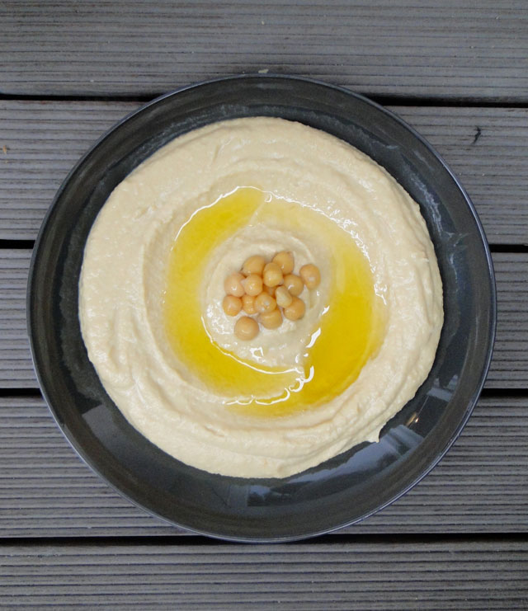
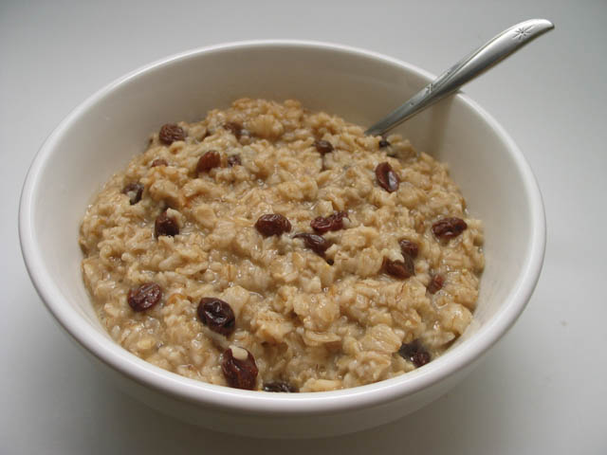
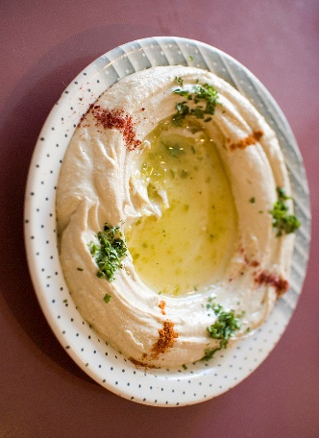
Which is better to eat pre-workout
Oatmeal vs.
Hummus

Slide 21
Why not the hummus?
Oatmeal is the winner
  Packed with fiber
  Easily digested
  Loaded with potassium and magnesium which is needed for energy
  Generally 1/3 cup is plenty before a workout
  Mix with milk for extra energy
Yes, hummus is a healthy snack but…..
Bean-based foods tend to be high in indigestible carbohydrates which may cause gas and bloating

Slide 22
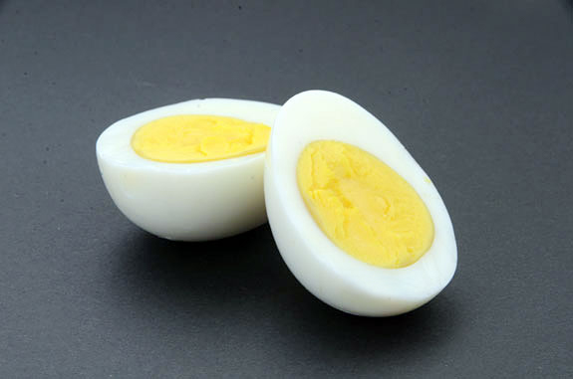
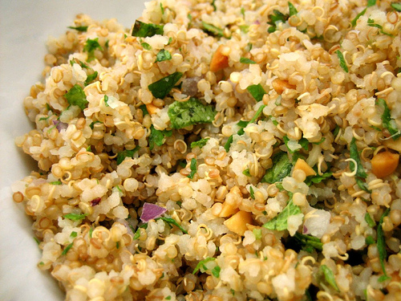
Which is better to eat pre-workout
Hardboiled eggs
vs. Quinoa

Slide 23
Why not the eggs?
Quinoa takes the win
  A grain that is packed with protein
    Provides carbohydrates for energy and protein for muscle building
    It is a complete protein source
  Packed with B vitamins, magnesium, and iron
  Perfect to help power a grueling workout
Hardboiled eggs are a great source of lean protein but they do not provide carbohydrates for energy
Protein also takes longer to digest, which can weigh you down during exercise

Slide 24
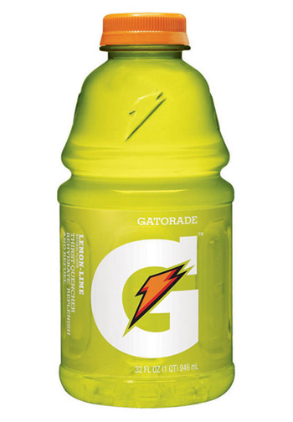

Which is better to eat post-workout
Chocolate milk vs.
Gatorade

Slide 25
Why not the gatorade?
The winner is chocolate milk
  Contains a 4:1 carbohydrate: protein ratio
    Very similar to commercial recovery beverages
  Provides fluids and moderate sodium needed for post-recovery
  Consumption immediately after exercise and again 2 hours post-exercise appears to be optimal for exercise recovery and may slow muscle damage
Just because Gatorade is marketed towards you doesn’t mean you need it
It is full of sugar!
Notes:
Chocolate milk has protein, carbohydrates, and fluids

Slide 26
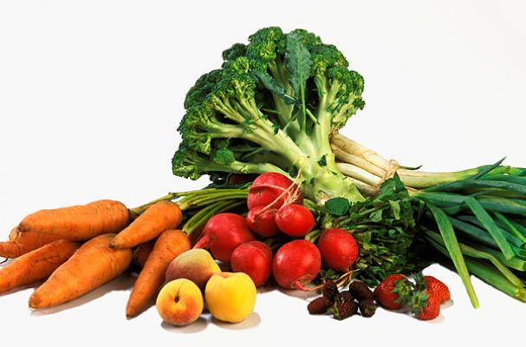
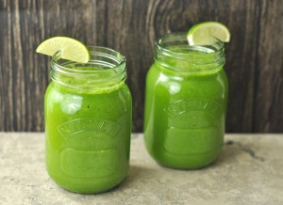
Which is better to eat post-workout
Raw vegetables vs. Green protein smoothie

Slide 27
Why not the raw veggies?
Lean green protein machine wins
  Protein to aid in recovery
    Protein can come from many sources: dairy milk, yogurt, nuts, oats, etc.
  Packed with vitamins and minerals
    Alkalizing nutrients like vitamin C and chlorophyll fight inflammation
  Easy to add healthy fats such as avocado or chia seeds
Raw vegetables are essential to a healthy diet
However, by themselves they are not substantial enough to replete what you have lost during the workout
You need protein and fiber to replenish and repair

Slide 28
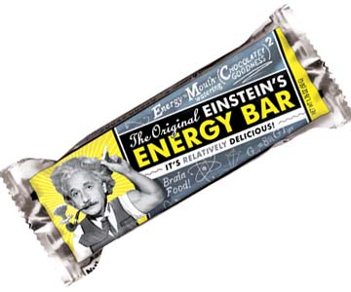
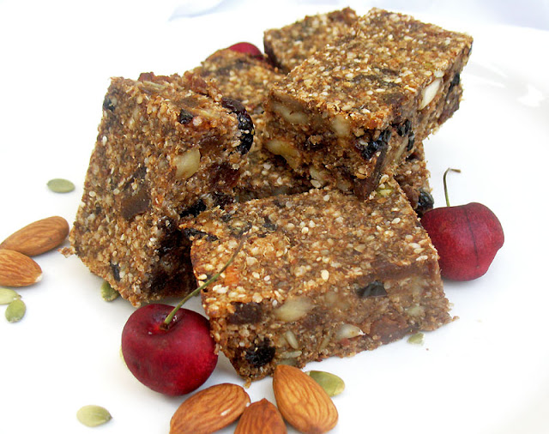
Which is better to eat post-workout
Energy bar vs. Fruit and nut bar

Slide 29
Why not the energy bar?
Fruit and nut bars get the win
  Contains easily digestible carbohydrates and fiber, along with healthy fats and protein which allow the carbohydrates to digest slower
    Slow digestion of carbohydrates provides more stable energy
  Extremely easy and affordable to make on your own
    Plenty of recipe ideas online and on social media!
These bars are designed to be eaten before a workout due to their high sugar content
Post-workout they may slow down your metabolism and make it difficult to sleep at night

Slide 30
Meal Planning for Student Athletes – When to eat?
First meal of the day should be consumed within 30 to 60 minutes after rising
A good rule of thumb is to not go longer than 5 hours without eating
Meals before a workout or sporting event should be consumed 4 to 6 hours prior
Snacks can be eaten 30 to 120 minutes before physical activity
  Remember carbohydrates are our immediate energy source
  A good snack would be half a banana with one tsbp peanut butter

Slide 31
Meal Planning for Student Athletes – What to eat?
Meals should be balanced – at least three of the five food groups should be present
  Example meals
    Breakfast: Omelet with spinach, and cheese
    Lunch: Tuna with whole wheat bread and grapes
    Snack:: Yogurt with granola and almonds
    Dinner: Brown rice with grilled chicken breast and roasted carrots
    Snack: Hummus with celery and crackers

Slide 32
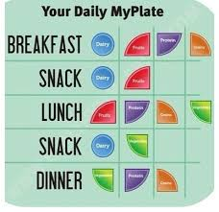

Slide 33
Healthy habits – family meal time
Stick by the two bite rule – your child doesn’t have to like it, but they have to try it and eat at least two bites
Eat together
  Studies show that kids who eat with their families have better eating habits and perform better in school
Eat a variety of colors
  Different colored fruits and vegetables provide different vitamins and minerals
Always have vegetables available
  Children are more likely to consume vegetables if they are available at every meal
  The same goes for fruits
Notes:
Raise your hand if you would consider your child a picky eater. How many times do you think you need to try something before you know if you like it? The answer is at least 8 times and that goes for us and our kids.

Slide 34
Healthy habits – family meal time
The more whole grains the better
  The MyPlate recommendation is to make half of your grains whole grains
Stick with low-fat dairy products
  The protein content of dairy does not change from full to non-fat, only the fat content changes
Don’t skip breakfast
  Your body needs energy as soon as you wake up
Drink more water
  Gradually water down your sugary beverages over the course of a few weeks, your taste buds will adjust slowly

Slide 35
Healthy habits – refer to myplate

Slide 36
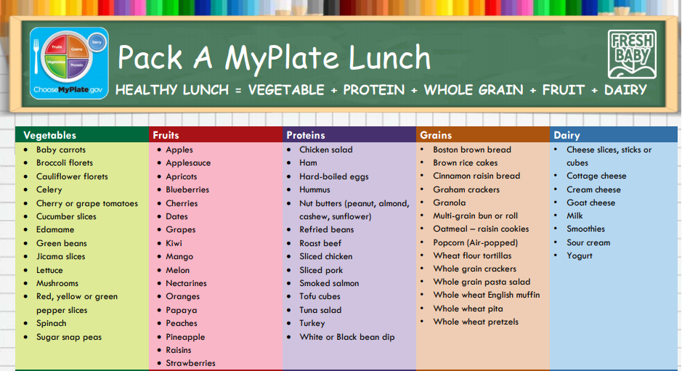

Slide 37
Nutrition During Practice and Games
Hydrate, hydrate, hydrate !
What to eat during practice and games
  If exercise is lasting more than 3-4 hours it may be necessary to consume a good source of carbohydrates such as an apple, banana, grapes, 1 slice bread, 4-5 whole wheat crackers
Remember CARBOHYDRATES and FLUIDS BEFORE and DURING exercise and PROTEIN and FLUID AFTER
For exercise lasting longer than one hour an electrolyte drink should be used
  Raise your hand if your first thought was Gatorade
  There are much better options on the shelves than Gatorade

Slide 38
The Basics – Hydration
It is extremely important for athletes to stay hydrated
  Dehydration can be life threatening and lead to injury
Water needs increase with increases in exercise
  The more sweat – the more water is needed
Water intake does not usually need to be limited

Slide 39
Water needs
Boys and girls ages 4 to 8 should drink 7 cups of water per day
Girls ages 9 to 13 should drink 9 cups of water per day
Boys ages 9 to 13 should drink 10 cups of water per day
Girls ages 14 to 18 should drink 10 cups of water per day
Boys age 14 to 18 should drink 14 cups of water per day

Slide 40
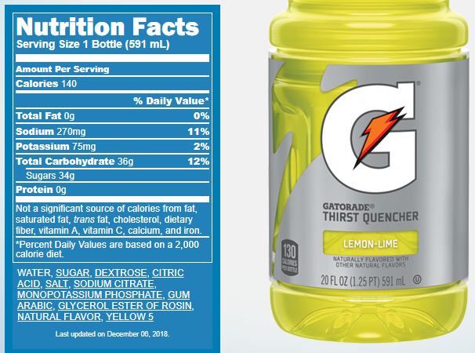

Slide 41
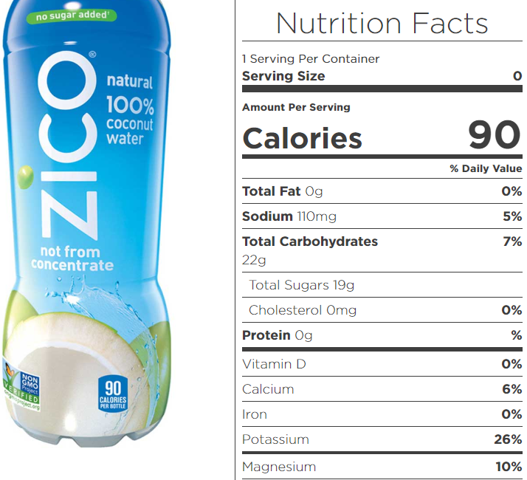

Slide 42
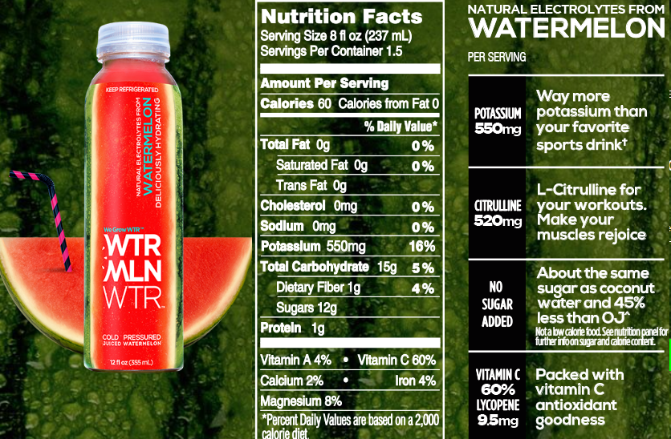

Slide 43
Electrolyte beverage Recap
Gatorade – first two ingredients are sugar, add artificial colors, 34 grams of added sugar per 20 ounces (kids are allowed about 25 grams of ADDED sugar per day), 2% potassium needs, 11% sodium needs (sodium is on the ingredient list), 140 calories
Zico coconut water – 100% coconut water, no added sugar, 19 grams of natural sugar, 26% potassium needs per 16.9 oz., 5% sodium needs, 90 calories
WTRMLN WTR – ingredients watermelon, watermelon rind, and lemon juice, 100% fruit juice, 18 grams of natural sugar per 12 ounce bottle, 24% potassium needs, 0% sodium needs, 90 calories

Slide 44
Benefits of Regular physical activity
Reduces the risk of developing many health complications
Increases happiness and decreases anxiety
  Exercise releases endorphins – triggers positive feeling
Improves sleep patterns
Gives more energy
Improves memory and concertation
Increases strength and flexibility

Slide 45
Take home points
Your body needs carbs to fuel your workout
  Carbs = energy
Protein helps repair muscles
  Always have protein after strength training
Food is fuel and function
  Put good in → get good out
Staying hydrated improve overall health and fitness
Always refer to credible sources for information on food and fitness

Slide 46
References:
Mohr CR. Timing your pre- and post-workout nutrition. EatRight Website. Available from http://www.eatright.org/resource/fitness/exercise/exercise-nutrition/timing-your-nutrition. Published Feb 13, 2017. Accessed March 22, 2017.
McClees H. Foods to keep on hand for healthy pre-workout eats. One Green Planet Website. Available from http://www.onegreenplanet.org/natural-health/clean-foods-to-keep-on-hand-for-healthy-pre-workout-eats/. Published Dec 17, 2016. Accessed March 22, 2017.
Smith J. 20 foods that can ruin your workout. Shape.com Website. Available from http://www.shape.com/healthy-eating/diet-tips/20-foods-can-ruin-your-workout. Accessed March 22, 2017.
Pritchett K, Pritchett R. Chocolate milk: a post-exercise recovery beverage for endurance sports. Med Sport Sci. 2012;59:127-134.
Jones T. 10 foods you should never eat after a workout. Life Hack Website. Available from http://www.lifehack.org/articles/lifestyle/10-foods-you-should-never-eat-after-workout.html. Accessed March 22, 2017.
Michaels J. Myth: Never eat before a workout. Jillian Michaels Website. Available from https://www.jillianmichaels.com/blog/food-and-nutrition/myth-never-eat-workout. Published Nov 11, 2015. Accessed March 22, 2017.

